Slide 1

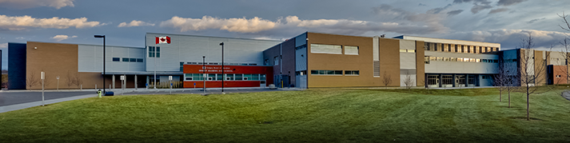
Ernest Manning High School ​
AP Information for Parents/Guardians of Grade 10 & Students New to AP
Sep. 2026
Mr. James Rubin​
AP Coordinator

Slide 2

Purpose of Advanced Placement (AP)
Take enriched, university-level coursework, while building confidence with the support and guidance of AP teachers
Potentially earn university credits with qualifying scores on AP Exams
In Canada, AP courses aren't typically required for entrance into post-secondary programs. Advanced credit is given upon admission

Slide 3

This Presentation is designed for Parents/Guardians of
Grade 10 students in AP-cohort classes
Students considering moving into an AP stream in the future
Students new to AP
Terminology:
AP-cohort Course: A class (often Grade 10 or 11) which is enriched and leads to an AP course
AP Course: A class (often Grade 12, occasionally Grade 11) leading to an AP Exam

Slide 4
AP vs IB
Similarities
Differences
Enriched academic ​program​
College credit can be ​earned based on exams scores
AP
Granting college credit is based on AP Exam score, written in May
Courses are “a la carte”
Flexibility is key!
IB
Student write the IB Exams in addition to completing other requirements
“Full” or “partial” IB Program

Slide 5
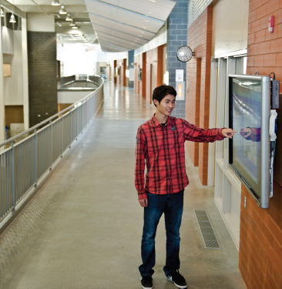
AP-Cohort Classes
AP Cohort classes are designed to prepare students for the rigors of AP courses
  Grades 10 (sometimes also grade 11)
Example Pathways:
  Social Studies 10-AP Cohort -> Social Studies 20-1/35AP (European History)
  Science 10 AP-Cohort -> Chemistry 20 AP-Cohort -> Chemistry 30/35AP

Slide 6
AP-Cohort Classes
Workload and Expectations
Each AP-Cohort covers some enrichment material to prepare students for the AP course in the pathway
Students are not disadvantaged by being in an AP-Cohort class
  Enriched material does not form part of the course grade, as it is beyond the curriculum
  Enriched material better prepares students for the next level, regardless of whether they remain in the AP stream!

Slide 7

Our 10-Level AP-Cohort Teachers
Social 10-1AP-Cohort: Mr. Schofield
ELA 10-1AP-Cohort: Ms. Esterhuizen
Science 10AP-Cohort: Mr. Cheng/Mr. McManus
Math 10C AP-Cohort: Ms. Leung/Mr. McMahon/Ms. Malmstrom/Mr. Freeman
Many of our other AP courses are blended AP-Cohort/regular stream at the 10 (and even 20)-level
Eg:
Computer Science
Art
Languages
Psychology

Slide 8

Students Considering Taking AP Course(s) in the Future
What if a student is not enrolled in an AP-Cohort Stream but wants to move into the AP stream for next year?
In many cases, strong students in the regular streams (non-AP Cohort) may still enter the AP stream in Grade 11 or 12
Please see the following document on the AP portion of the EMHS Website:
“Current Students Considering Taking AP Courses in the Future”

Slide 9
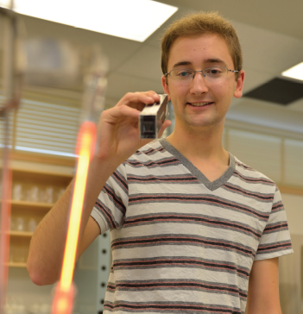
For Students Enrolled in AP Classes (Gr. 11/12)
These courses are:
  Art-Drawing/Sculpting
  Biology
  European History
  Calculus AB
  Chemistry
  Computer Science A
  Chinese (Sem 2)
  Spanish Language (Sem 2)
  French Language (Sem 2)
  English Lit (Sem 2)
  Physics 1 (Sem 1 only)
  Psychology (Sem 2)
Year-long/Sem 1 courses began in Sept
Sem 2 courses begin in Feb 2027
Cost of each AP exam is $150 (payable via PowerSchool account)
  Year-long/Sem 1 courses: Due Nov. 1
  Sem 2 courses due early March
AP Exams (and portfolios) are written in May

Slide 10

For Students Enrolled in AP Classes (Gr. 11/12)
If a student is enrolled in an AP course but wants to opt out of writing the AP exam:
For a full refund, students indicate this to me by Nov. 1
Any time prior to day of exam: Refund minus $60 as late fee (paid to College Board)

Slide 11
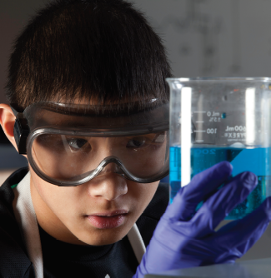
For Students Enrolled in AP Classes (Gr. 11/12)
AP Exams
Scores are reported in early July on College Board’s myAP site
Students may indicate which colleges and universities should receive score reports
A grade of 4 or 5 (out of 5) is generally enough to receive university course credit at most Canadian universities

Slide 12
For Students Enrolled in AP Classes (Gr. 11/12)
AP Exams must be written on the date/time indicated:
Mon May 3: Biology (12pm)
Tues May 4: European History (12pm)
Weds May 5: English Lit (8am)
Weds May 5: Physics 1 (12pm)
Thurs May 6: French (8am)
Thurs May 6: Physics 2 (8am) - challenge only
Thurs May 6: Chemistry (12pm)
Fri May 7 - Art portfolios due (9:59pm)
Thurs May 13: Spanish Language and Culture (8am)
Thurs May 13: Chinese (12pm)
Fri May 14 - Psychology (12pm)
Thurs May 20: Computer Science A (8am)
Thurs May 20: Calculus AB/BC (12pm)

Slide 13
For Students Enrolled in AP Classes (Gr. 11/12)
For May 2027, students enrolled at EMHS may independently challenge the following AP exams that we don't offer as courses:
Please see Mr. Rubin prior to Nov. 1 if you'd like to challenge these exams.
Calculus BC - Thurs May 20: Calculus AB/BC (12pm)
  Note: Restricted to students currently enrolled in, or have completed Math 30/31AP
Microeconomics - Tues May 4: Microeconomics (12pm)
  Note: conflicts with AP European History Exam at the same time
Macroeconomics - Fri May 7: Macroeconomics (12pm)
Physics 2 - Thurs May 6: Physics 2 (8am)
Statistics - Fri May 21: Statistics (8am)

Slide 14
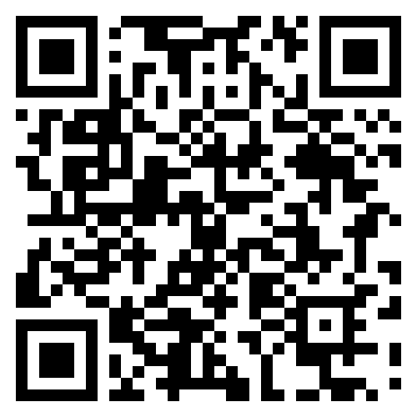
Your Turn!
If we could offer other AP selections as courses with Exams in the future, which would you be interested in?
Select all that apply!
Microeconomics
Macroeconomics
Statistics
Physics 2
Music Theory
CyberSecurity
https://forms.gle/nBoZRcohZ2bQi8uRA

Slide 15
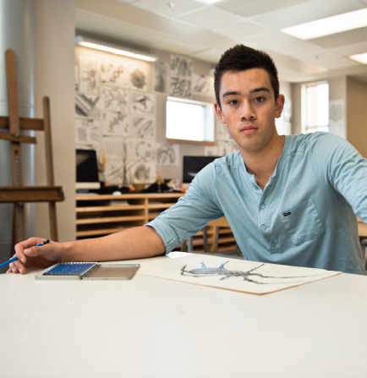
Questions About AP or AP-Cohort
Students with questions:
Chat with their teacher
Students can see me in Room 2208 (morning or after school)
jrrubin@cbe.ab.ca
  Parent questions
Info on EMHS Website

